Slide 1
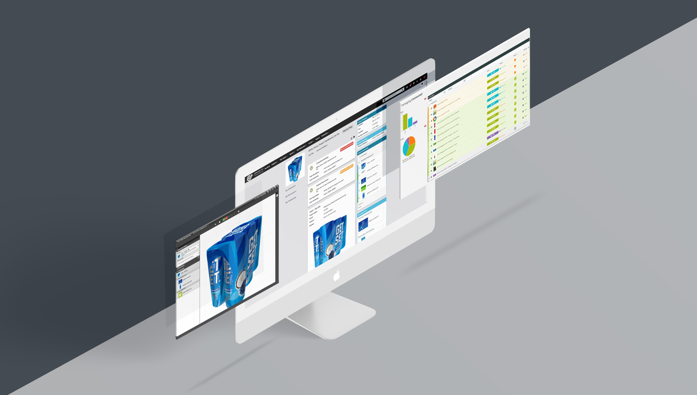
WEBCENTER 18.1
SALES TRAINING
Product Management
April 2019

Slide 2
WebCenter
Refresh
Products

Slide 3
?
Creating Packaging requires collaboration
CSRs
Customer
Sales Rep
Design Manager
Sales Manager
Structural Designer

Slide 4
Let WebCenter become your company’s digital nervous system
Customer
CSRs
Sales Rep
Design Manager
Sales Manager
Structural Designer

Slide 5
Concept
Problem: Unstructured communication causes unnecessary pressure on associates and erodes productivity and customer satisfaction.
Solution: Now all customer job requests are standardized. Associates and customers are guided to do the right thing at the right time. All communication is systematically tracked and risks are flagged ahead of time. The same team now handles more jobs.
How
First time right briefing and job specfication
Reduced Approval time and iterations
Project visibility/reports and insights

Slide 6
Process Management
Specification
Search & Reports
Approval
Integration

Slide 7
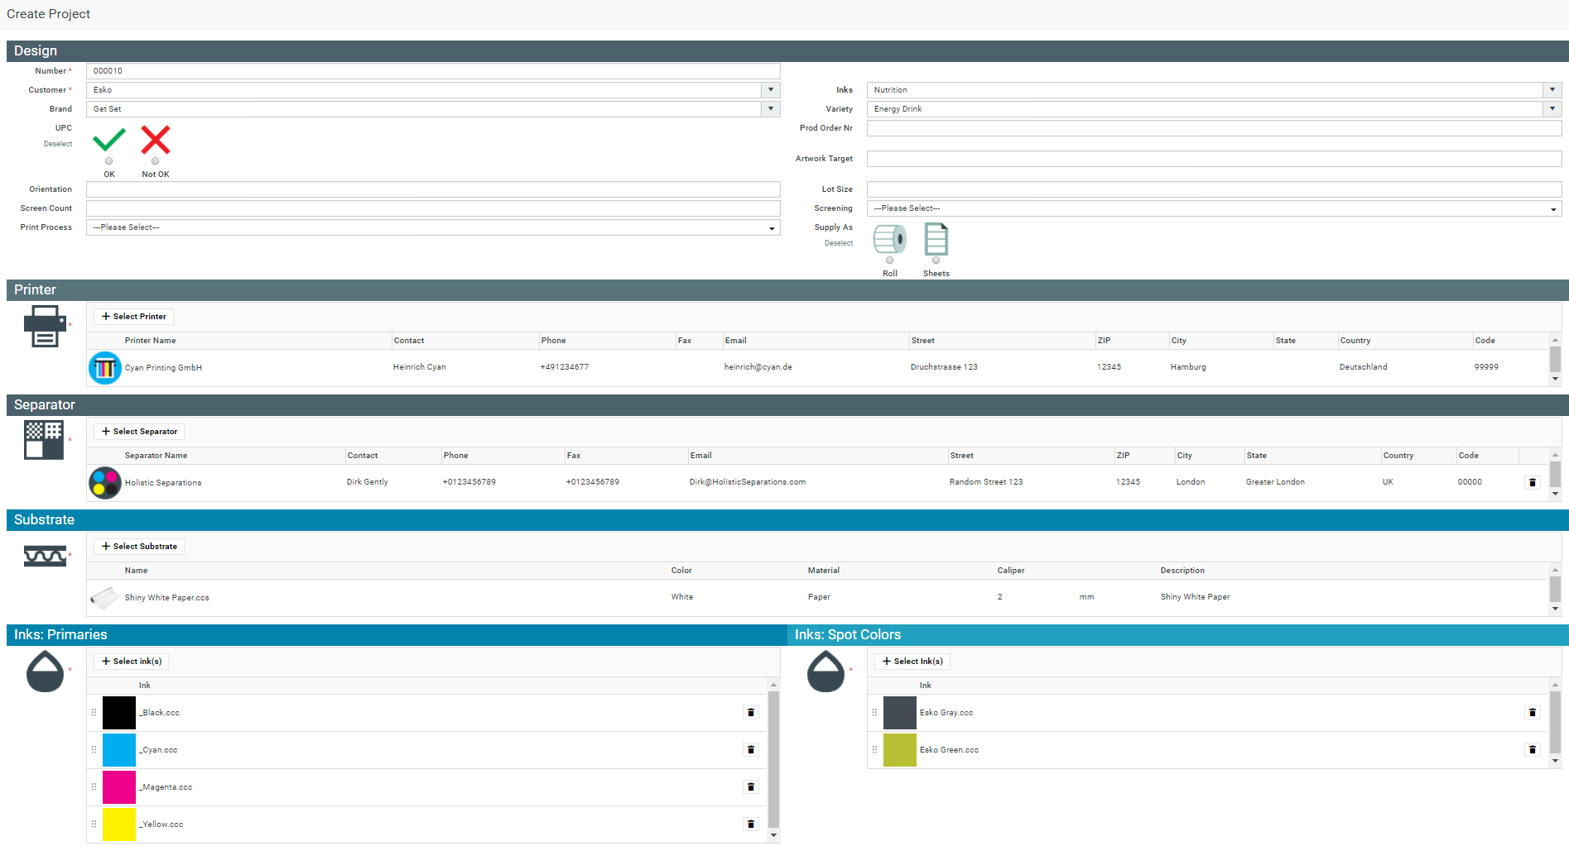
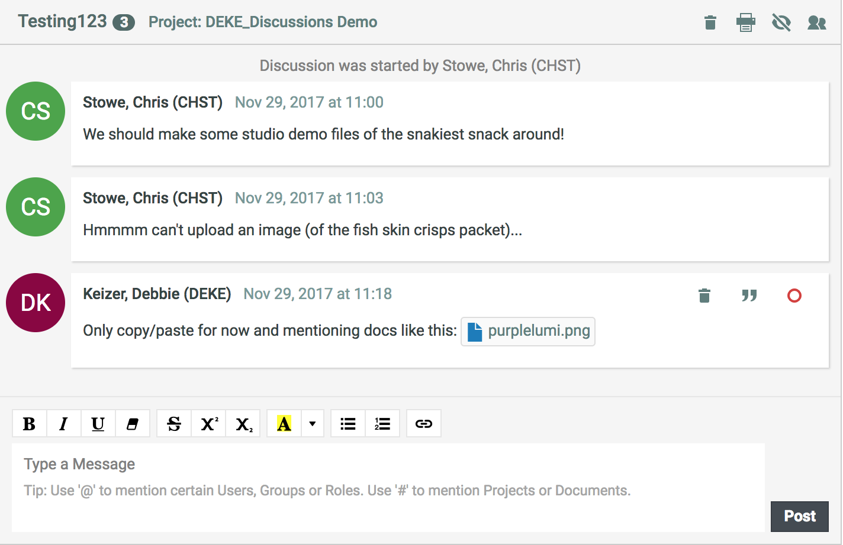
Specification
New requests can be initiated with more quality spending 1/6 of the time

Slide 8
Process Management
50% lead time reduction on packaging creation/update project with half the resource utilization

Slide 9
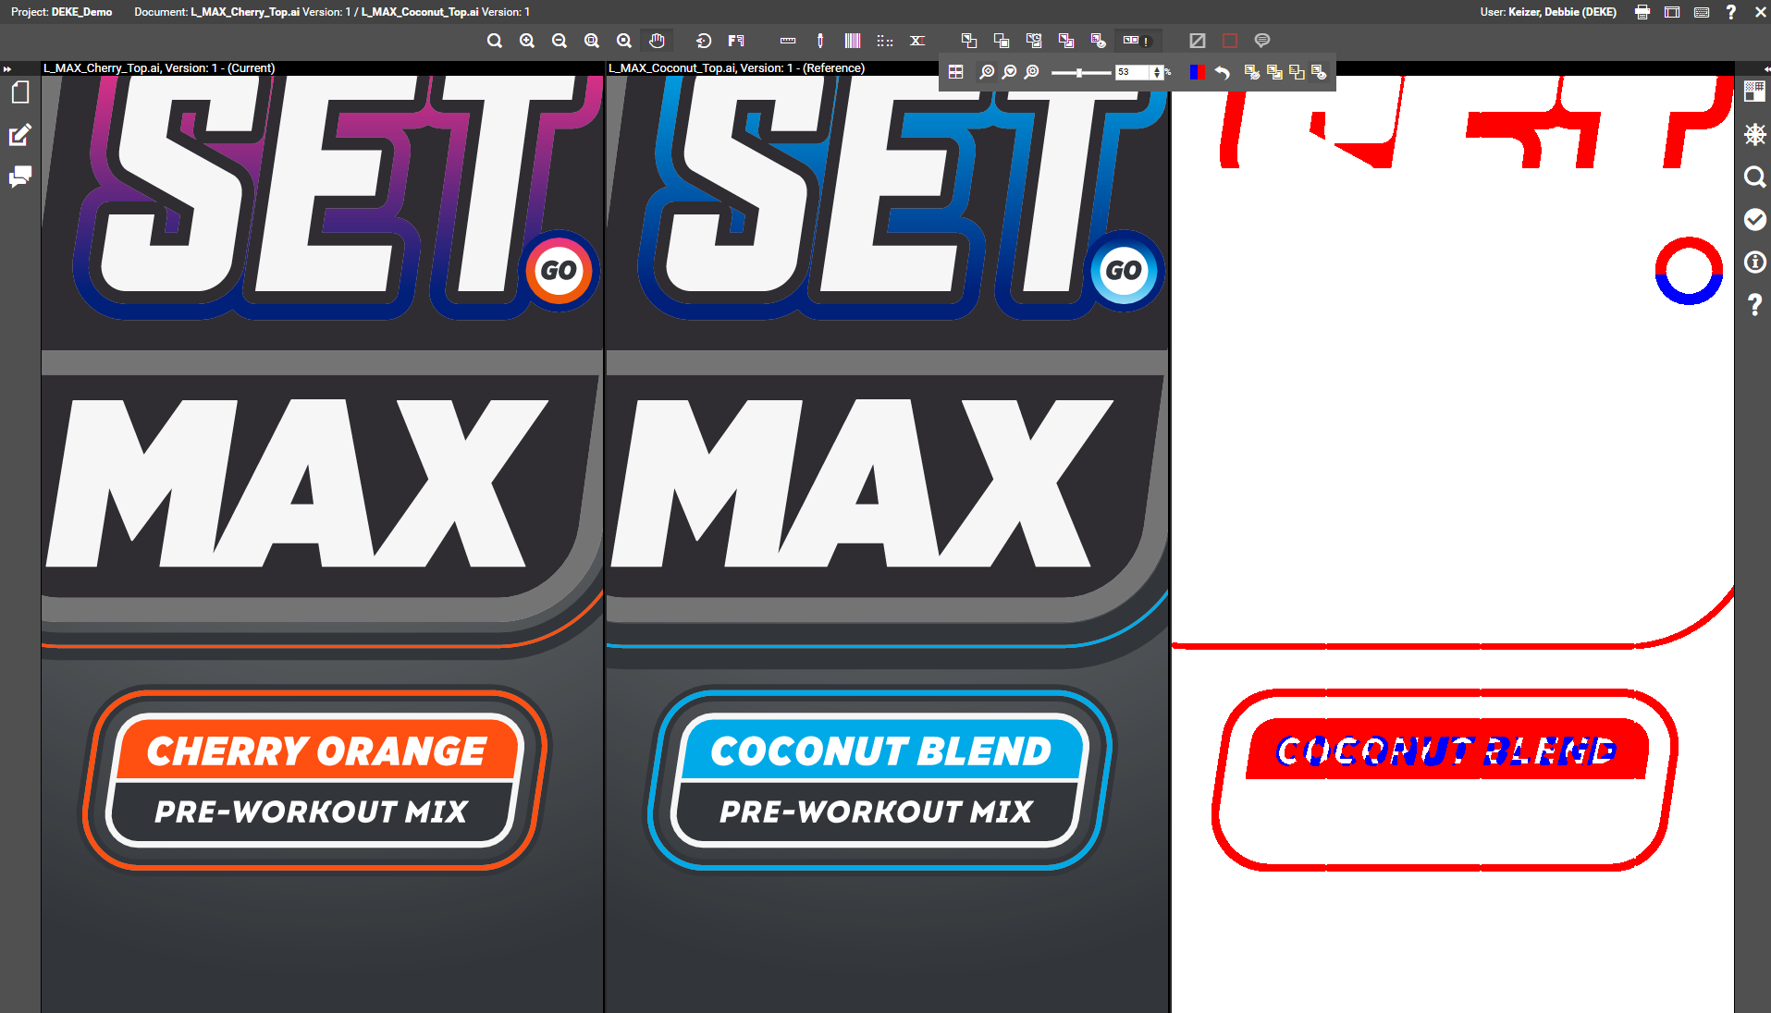
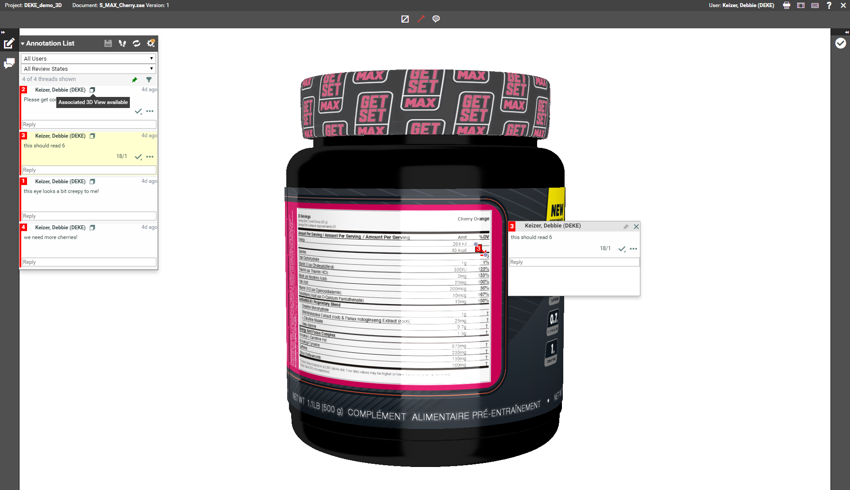
Approval
Approval Cycles are 3 times faster and number of revisions reduced by 60%

Slide 10
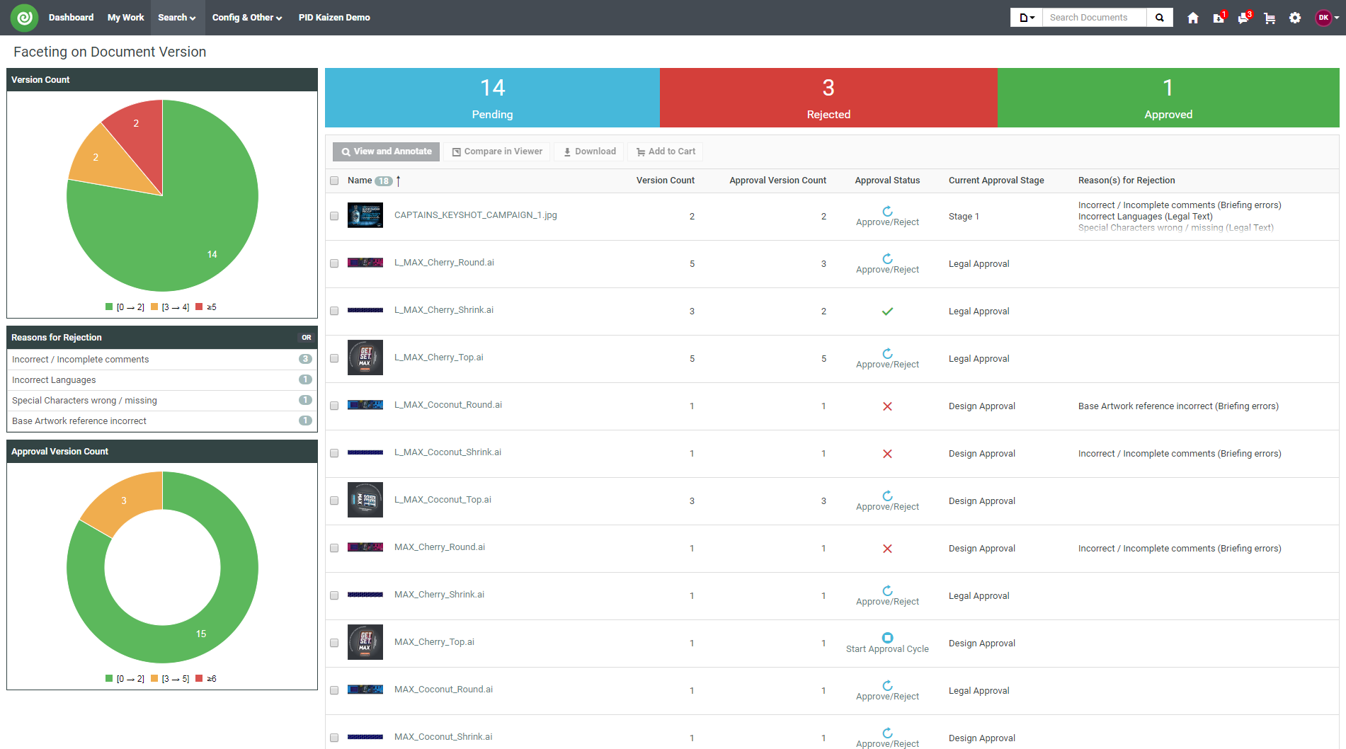
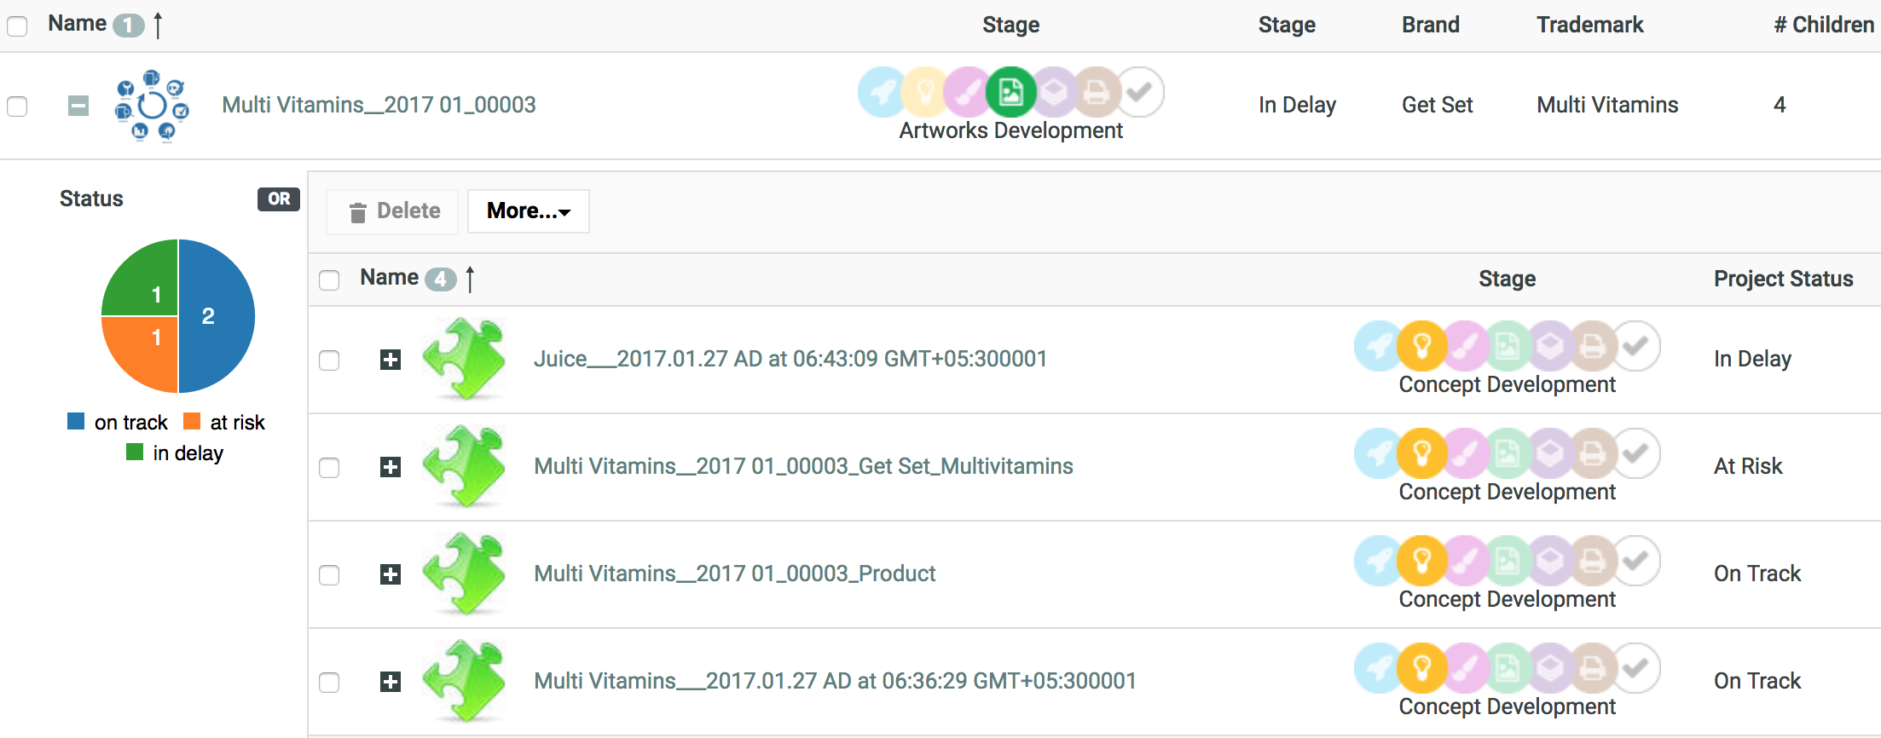
Search & Reporting
Better Risk management and visibility on bottlenecks for continues improvement

Slide 11
Automation
Engine
Illustrator
Integration
MIS/ERP
Reduce risk, avoid data duplication and speed up handover
ArtiosCAD
Studio
Brand

Slide 12
WebCenter 18.1
New Innovation Stories
Products

Slide 13
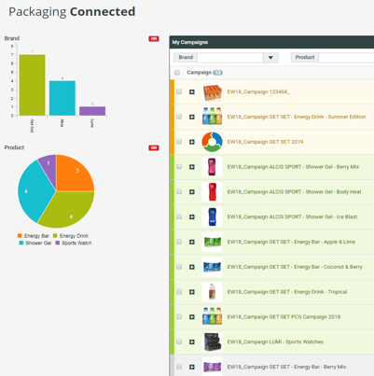
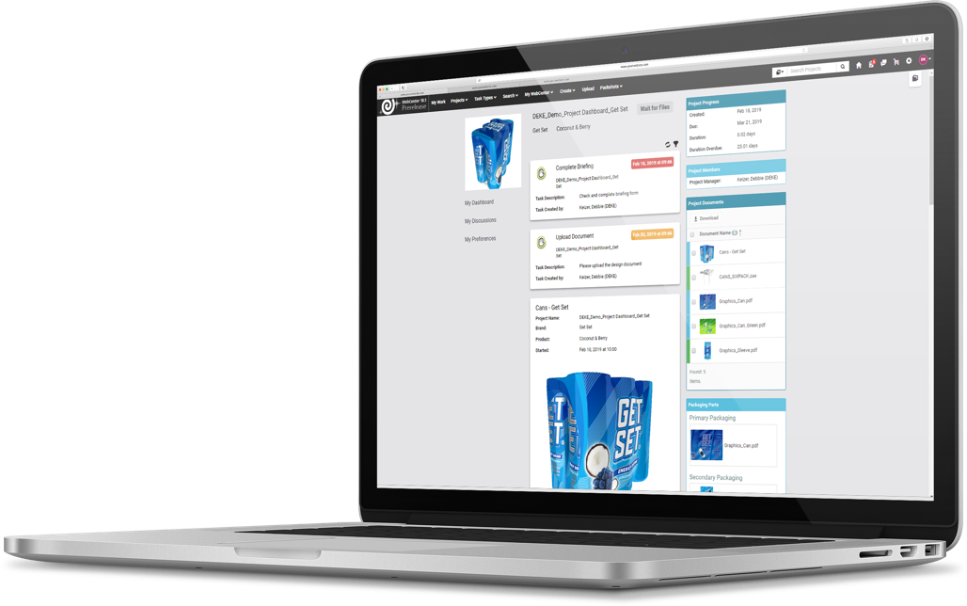
WebCenter 18.1
Social Media Inspired UX
Faster user adoption
Easier buy in from other departments
Reduce training cost
Improved Reporting
More visual than ever to detect risks faster
Easier KPI reporting and analysis
Fully localized to your needs
Dynamic 3D
High quality 3D virtual mockups in minutes
Confidential – For Internal Use Only

Slide 14
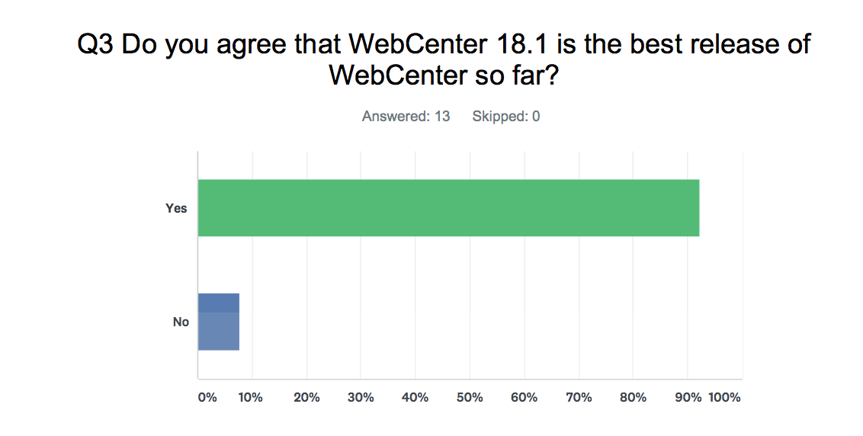
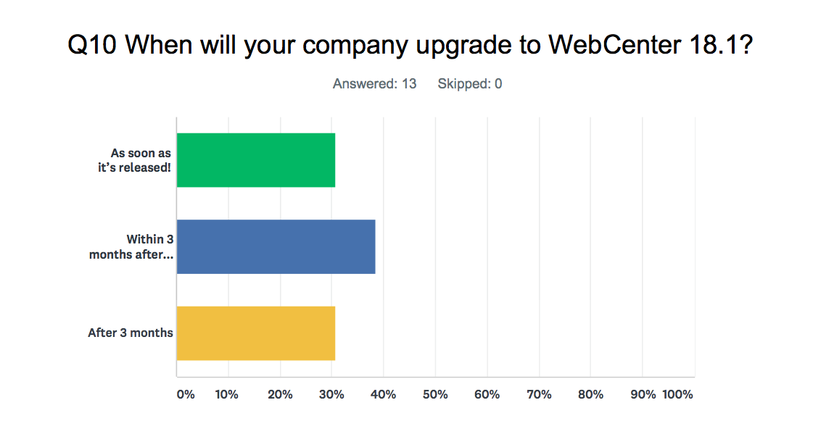
Inner Circle Early Feedback
Confidential – For Internal Use Only

Slide 15
a better
user experience story
for Jeroen

Slide 16
Jeroen: Graphical Operations Manager
As the Graphics Operation Manager he is responsible for the WebCenter system that has been put into place in order to guide the prepress, structural design and printing operations.
Jeroen has a technical background and is very hands on! He’s not afraid to start playing and tinkering with workflows to further improve the system.
He’s responsible for the adoption of the system and hopes that every person working with the system sees the benefits of working this way.
Likes to automate as much as possible and expand the application of the system to handle customer and sales requests.
Champion of Esko!
About Jeroen
36 years old
Lives together with his girlfriend
Background in graphic and packaging design
Works long hours
Reports to CEO
Confidential – For Internal Use Only
Notes:
TODO ADD his KPI, his Drive Antony – Saint Luc Bela – Tetra Pak Daniel - Fujiseal

Slide 17
Jeroen: Challenges
Buy-in Convince other people to further roll this out. (e.g. The sales organization is going to be skeptical and will only be on board if they can offer their customers an easy to use and modern looking application)
Customization It’s important that Jeroen can tailor and tweak the system for a particular customer (e.g. A converter typically gets the majority of their business from a few big customers, it’s important that they can customize the forms and the look and feel of the application to these customers)
New Users Young new employees and customers have new expectations when working with software. It has to be intuitive and require minimal training, they should be able to self teach. (e.g. Millennials take up 40% of the total workforce)
About Jeroen
36 years old
Lives together with his girlfriend
Background in graphic and packaging design
Works long hours
Reports to CEO
Confidential – For Internal Use Only
Notes:
TODO ADD his KPI, his Drive Antony – Saint Luc Bela – Tetra Pak Daniel - Fujiseal

Slide 18
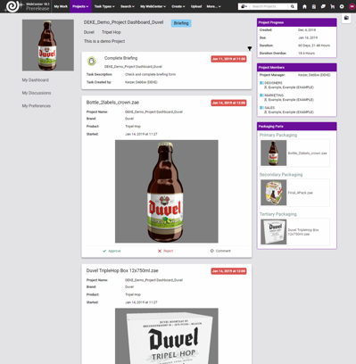
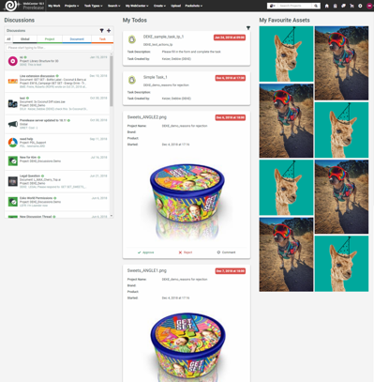
Demo: A New User Experience Story
WebCenter 18.1 allows you to display the most critical project information in a social media-inspired user interface, familiar to both frequent and infrequent users.
Confidential – For Internal Use Only

Slide 19
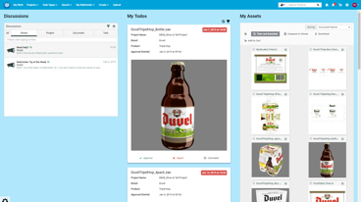
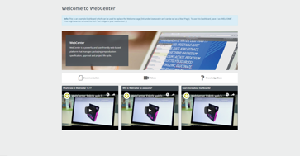
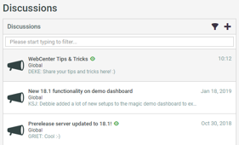
How can WebCenter help?
A social media-inspired UI that supports new user adoption
Familiar user experience for both new and current users
Supports both classic view and new view
Configurable per user group
Powerful dashboards summarize all tasks and approvals with relevant information for a user
All activities for a non-frequent user in a single dashboard
Look and feel based on user group using drag & drop
Global Discussions make it easy to send out Tip’s and Tricks
Drive collaboration with frequent user interaction
Confidential – For Internal Use Only

Slide 20
What’s the value?
User Adoption
Because of the Social Media Inspired UI and Dashboards, users find it a breeze to work in WebCenter and use it when they can.
Buy-in From Other Departments
When showing the artwork management system to other departments, they quickly understands how it works and see the value.
Reduced Training Cost
Because the system is so intuitive, less training is needed!
Dashboards and the global discussions make it easy to get your training material to your users.
Confidential – For Internal Use Only

Slide 21
a better
reporting story
for Maarten

Slide 22
Maarten: Managing Director
Maarten founded the company 20 years ago.
He has a technical background but makes mostly business decisions these days.
He’s a busy man but he still likes to be closely involved in daily operations.
Like any Managing Directors he wants to expand and modernize by extending his existing customer base.
He tries to beat the competition by offering the best service and quality for the same price.
Wants to bring costs down to get a better margin
About Maarten
54 years old
Married with children
Background in graphic and packaging design
Works long hours
Appreciates a good coffee and “broodje kroket”
Confidential – For Internal Use Only
Notes:
TODO ADD his KPI, his Drive Antony – Saint Luc Bela – Tetra Pak Daniel - Fujiseal

Slide 23
Maarten: Challenges
Visibility Due to his lack in time, he doesn’t have a lot of time to follow up closely on his employees but he still doesn’t want to be kept in the dark when it coms to the daily operations.
Improvement He want’s to know where the bottlenecks in his company are. Get some insight in where he could best improve to protect his margin.
Modernization He wants to show to his customers that his company is a modern and keeps up with the latest technology.
About Maarten
54 years old
Married with children
Background in graphic and packaging design
Works long hours
Appreciates a good coffee and “broodje kroket”
Confidential – For Internal Use Only
Notes:
TODO ADD his KPI, his Drive Antony – Saint Luc Bela – Tetra Pak Daniel - Fujiseal

Slide 24
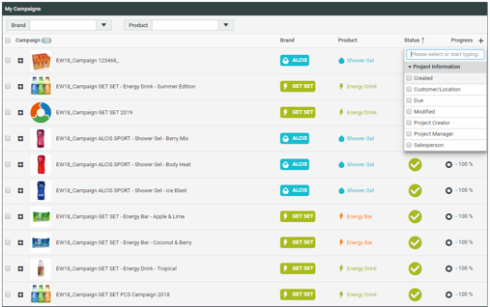
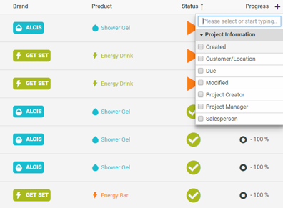
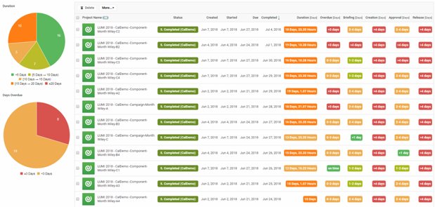
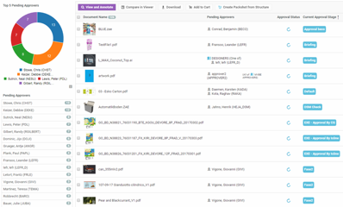
Demo: A New Reporting Experience Story
WebCenter 18.1 improves both Search and Reporting capabilities with a smarter approach to information visualization and richer search criteria.
Confidential – For Internal Use Only

Slide 25
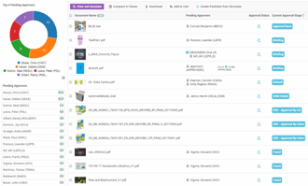
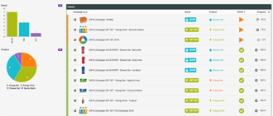
How can WebCenter help?
Pending Approvals feature replaces the need to analyze why a project has stalled
Users can self-serve by analyzing all approvals for their project(s)
Users can additionally drill-down on projects to find pending approval stall point
KPI metrics are easily understood and reported
Search on start date, due date, completed date
Search on duration and time left of the item
Conditional Formatting of dashboards provides more context for project status
New Dashboard allows to combine multiple KPI dash board into one
One or more KPI reports can be combined and presented in one dashboard
Easy to create and configure using drag & drop capability
Confidential – For Internal Use Only

Slide 26
What’s the value?
Reduced daily requests
Ability to self-serve improves user experience while decreasing demands on Maarten’s time
Users can understand bottlenecks quicker and reduce time to market
Increased visibility to process and outcomes
Ability to report on KPI metrics unlocks ease of investment justification
Improved reporting will help company understand how to improve processes
Confidential – For Internal Use Only

Slide 27
a better
3D experience story
for Julie

Slide 28
Julie: Commercial Director
Julie joined the company six years ago and started out as a sales woman and worked his way up from there.
She would like to create more time for her sales team to go out and win new customers.
She wants her sales team to show that they can offer an unmatched service.
She controls all communication to customers.
About Julie
41 years old
Married with children
Takes initiative, thinks out of the box
Appreciates a good Gin & Tonic with botanicals.
Confidential – For Internal Use Only
Notes:
TODO ADD his KPI, his Drive Antony – Saint Luc Bela – Tetra Pak Daniel - Fujiseal

Slide 29
Julie: Challenges
Margin She needs to show the quality of service that her company offers in order to protect the margin. (E.g.: If she could offer logins to customers and nice 3D models of their packaging, she can differentiate from her competitors and show that you)
Time to Market Customers demanding more transparency on their requests and orders (E.g.: Everyone is pushed to produce packaging much faster and if you can offer more transparency to your customer, they will appreciate the extra service and also save time for everyone)
Self Sufficiency Minimize the need to interrupt other departments, give them more tools. (E.g.: If a customer calls her sales representative for an update, he needs to call different people in different departments to figure out that information. If they both had access to WebCenter, they could login, navigate to the project and get all that information on the fly)
About Julie
41 years old
Married with children
Takes initiative, thinks out of the box
Appreciates a good Gin & Tonic with botanicals.
Confidential – For Internal Use Only
Notes:
TODO ADD his KPI, his Drive Antony – Saint Luc Bela – Tetra Pak Daniel - Fujiseal

Slide 30
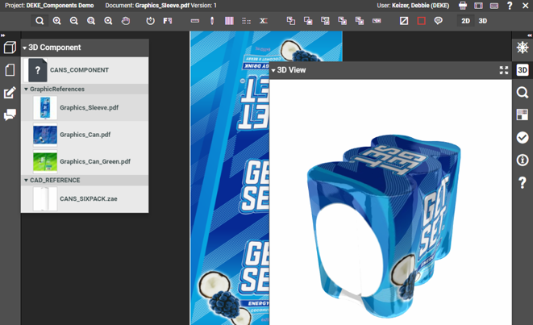
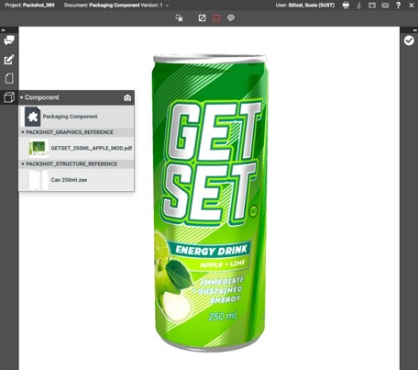
Demo: A New 3D Experience Story
WebCenter 18.1 reduces the cost of physical prototyping, delivers clear communication that limits the need for face-to-face meetings, increases decision-making and speed-to-market.
Confidential – For Internal Use Only

Slide 31
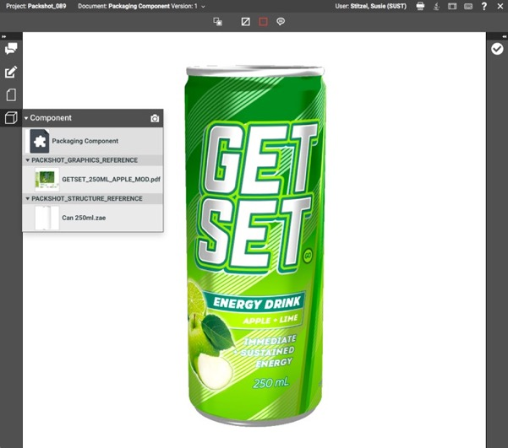
How can WebCenter 18.1 help?
Customers can now online review their artworks in 3D
This can be a unique service that the competition can not offer.
These 3D representations can be created at almost no extra cost to the company.
Some mistakes can go unnoticed in 2D (e.g. overlapping barcode etc.)
Confidential – For Internal Use Only

Slide 32
What’s the value?
An Innovation Hero!
Delivered a 3D solution as a seamless extension of the company’s existing services to customer at almost no extra cost!
Better Quality
The reviewal of artwork in 3D improves Quality, some mistakes go unnoticed in 2D.
Confidential – For Internal Use Only

Slide 33
WebCenter 18.1
Social Media Inspired UX
Faster user adoption
Easier buy in from other departments
Reduce training cost
Improved Reporting
More visual than ever to detect risks faster
Easier KPI reporting and analysis
Fully localized to your needs
Dynamic 3D
High quality 3D virtual mockups in minutes
Confidential – For Internal Use Only

Slide 34
WebCenter 18.1
Additional
New Features
Products

Slide 35
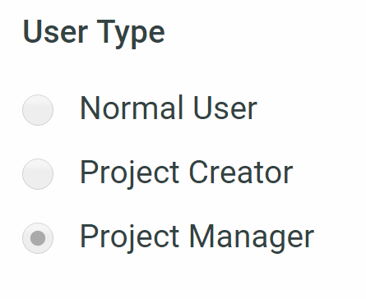
Allow Normal Users to Create Projects
Normal users can now freely create projects allowing your users to create request or orders without them needing to be a project manager.
Note: For Normal Users to create projects, each Normal named user will need to be designated in the system as a Project Creator
Confidential – For Internal Use Only

Slide 36
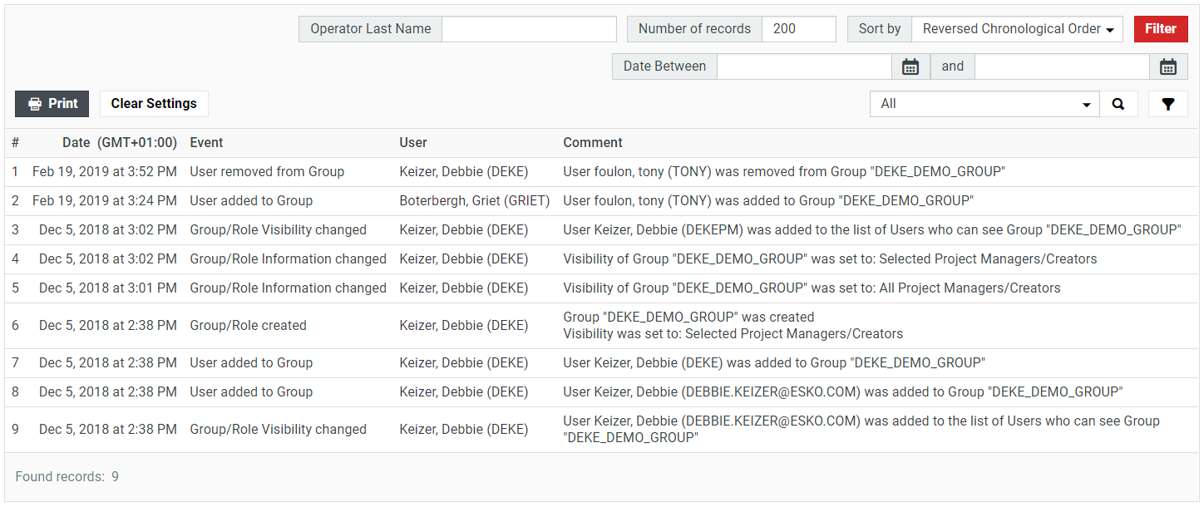
Group/Role History
We extended the audit trail further by now including actions around role and group membership in the history. (E.g. You can now see when somebody was removed from the ADMINS group)
Confidential – For Internal Use Only

Slide 37
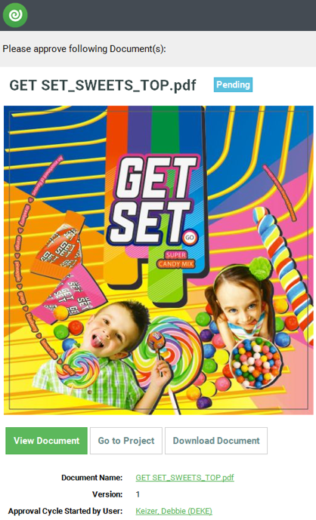
Document Thumbnails
Document Thumbnails are important as they tell you a lot about the document, we now embed big thumbnails in the approval emails! (Did we tell you that you can now also create your own for 3D models?)
Confidential – For Internal Use Only

Slide 38
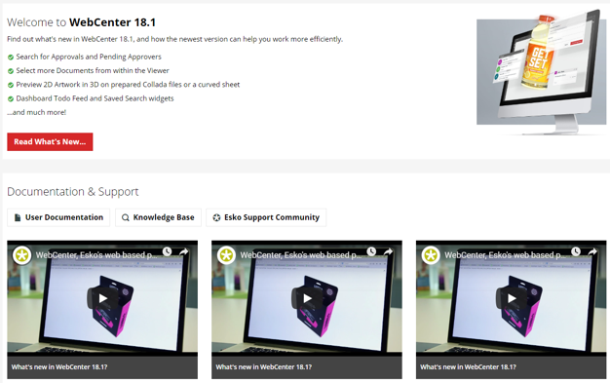
Welcome/Contact Dashboard
Your Welcome page in WebCenter is important, you often want to include links, video’s, etc. on this page. Using our new Dashboard builder you can now create your own custom Welcome pages! This way you have total freedom when designing these.
Confidential – For Internal Use Only

Slide 39
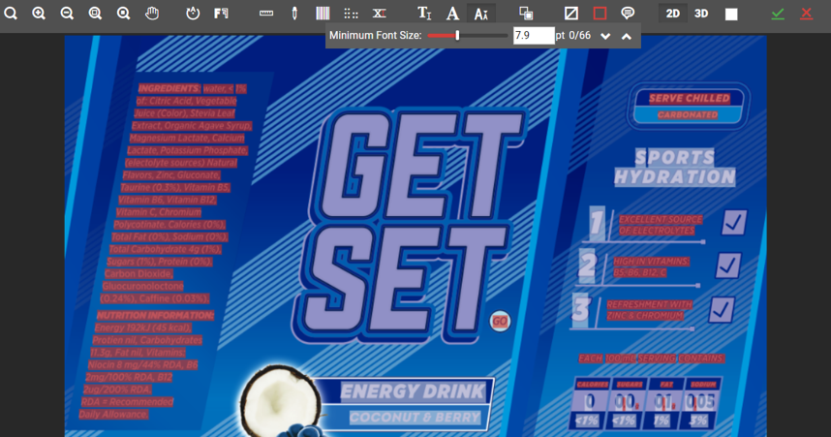
Demo: Text Selection
The WebCenter viewer now also supports Text! We now support the selection and inspection of live text embedded in your graphics.
Confidential – For Internal Use Only

Slide 40
Demo: Improved Running of a Standard
Utilize calculated attribute values to more easily run more ACAD Standards, support for Grain/Flute Directions and Print Sides.
Confidential – For Internal Use Only

Slide 41
New WebCenter 18.1 Features: Summary
Improved UX
Global Discussions
New Dashboard UI
Project Dashboards
To Do Feed
Saved Search Widget
Selection Details Panel
Viewer Document Selector
3D Improvements
Components View on Curved Sheet
CAD Improvements
Reporting
Search UI & Settings
Conditional Formatting
Approval/Task Search
Pending Approvers
Duration Search
Folder Search
Additional New Features
Project Creator
Group/Role History
Document Thumbnails
Welcome/Contact Thumbnails
View Text Tools
Confidential – For Internal Use Only

Slide 42
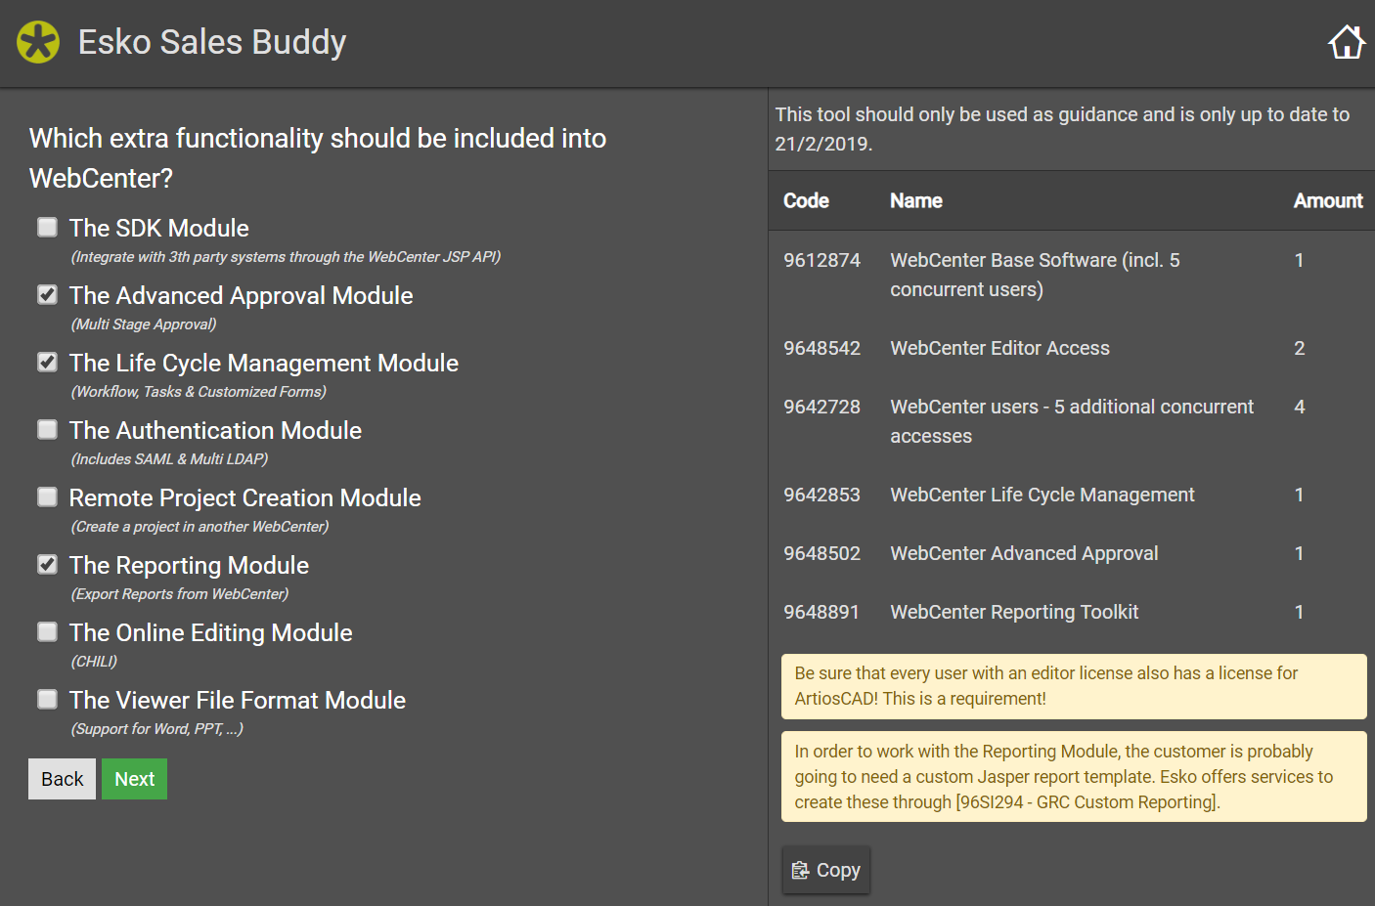
Esko Supplier Pricebook: Product Codes Identifier
Visit http://salesbuddy.esko.com from within the Esko network (VPN!) and let the tool guide you in selecting the correct product codes.
Notes:
Jasper reports included in Advanced base free of charge

Slide 43
Questions?
Notes:
Add more for running

Slide 44
Upcoming Training Sessions
Notes:
Add more for running

Slide 46
Appendix
Notes:
Add more for running

Slide 47
Project Dashboard
The Project Dashboard can be a new landing page for your users.
It allows you to display the most critical project information in a social media inspired user interface familiar to infrequent users.
The Project Dashboard can be completely localized using the new Dashboard framework.

Slide 48
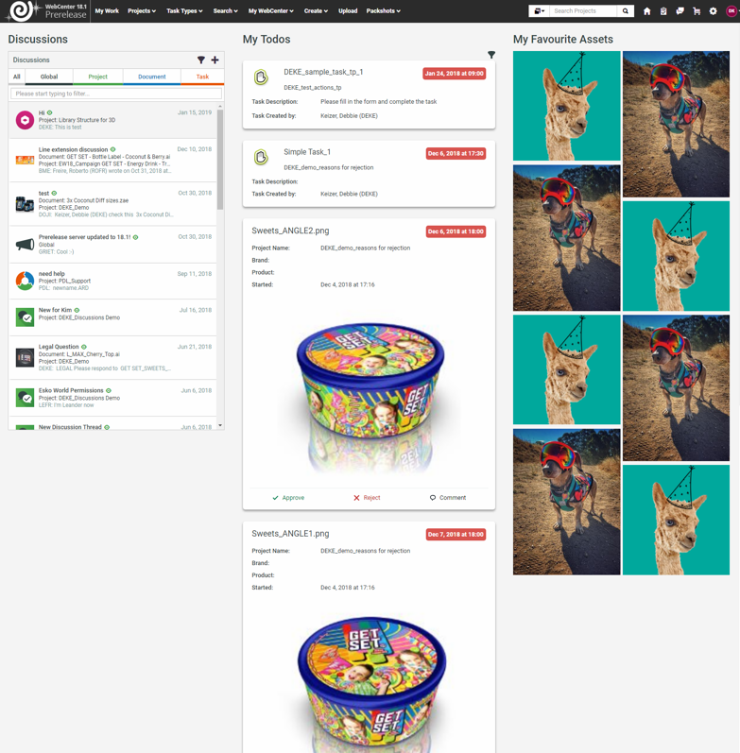
My Work Dashboard
The new My Work Dashboard can be fully customized to the needs of your user and offers a brand new ‘Todo Feed’
Social media inspired user interface from where actions can immediately be completed

Slide 49
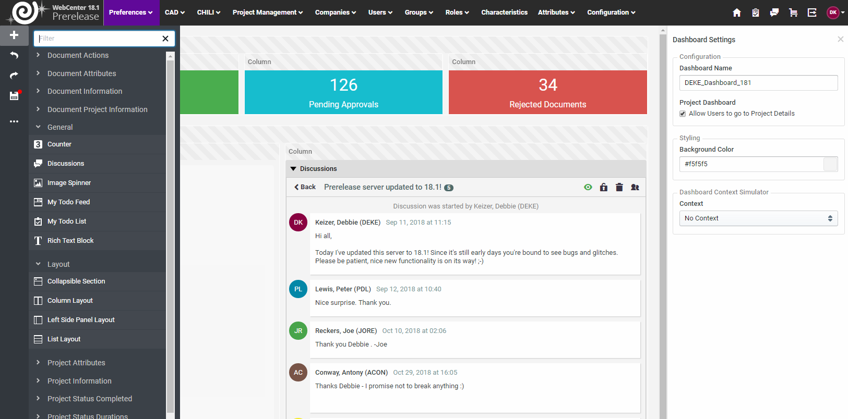
Dashboard Builder
Build and customize powerful dashboards using our brand new cutting edge Dashboard builder.
What goes here?

Slide 50
Component Viewing
View Complex 3D products in the viewer and live swap the 2D graphics

Slide 51
Allow Normal Users to Create Projects
Normal users can now freely create projects allowing your users to create request or orders without them needing to be a project manager.
Note: For Normal Users to create projects, each Normal named user will need to be designated in the system as a Project Creator
Confidential – For Internal Use Only

Slide 52
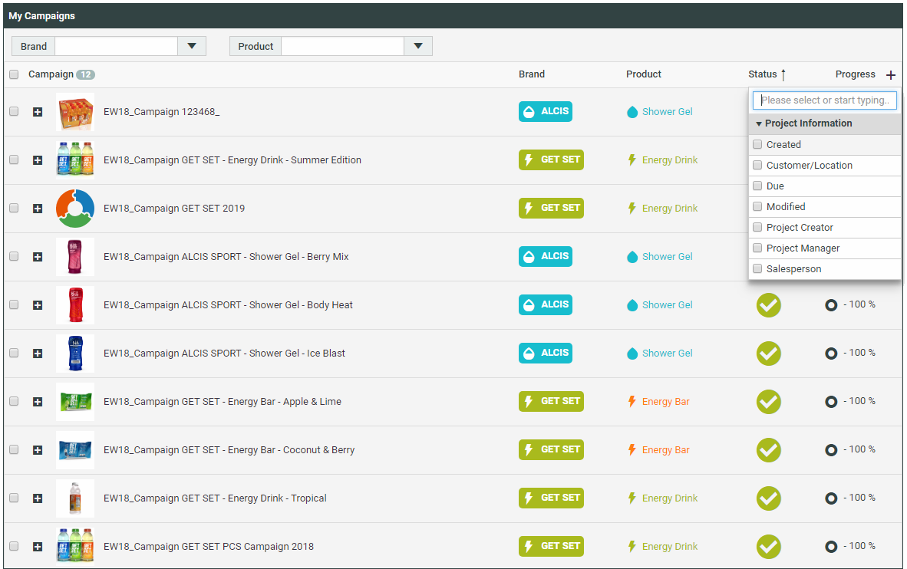
Conditional Formatting
Make your searches more visual, if a task or project is due, show that in a bright color or a custom icon.

Slide 53
Search Based on Duration
Search based on how long projects, tasks, approvals are ongoing and see which one are close or past their due date.

Slide 54
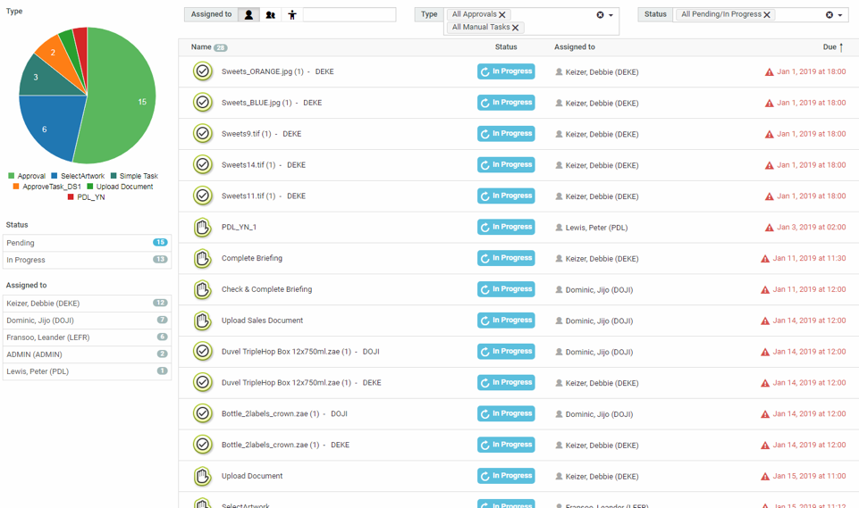
Combining Approvals and Tasks
You could already search for tasks in WebCenter but now you can search for Approvals as well and show them in the same search

Slide 55
Show Pending Approvers
You could already search for tasks in WebCenter but now you can search for Approvals as well and show them in the same search

Slide 56
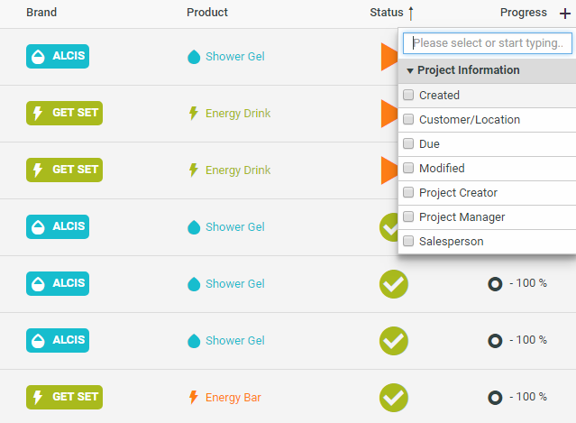
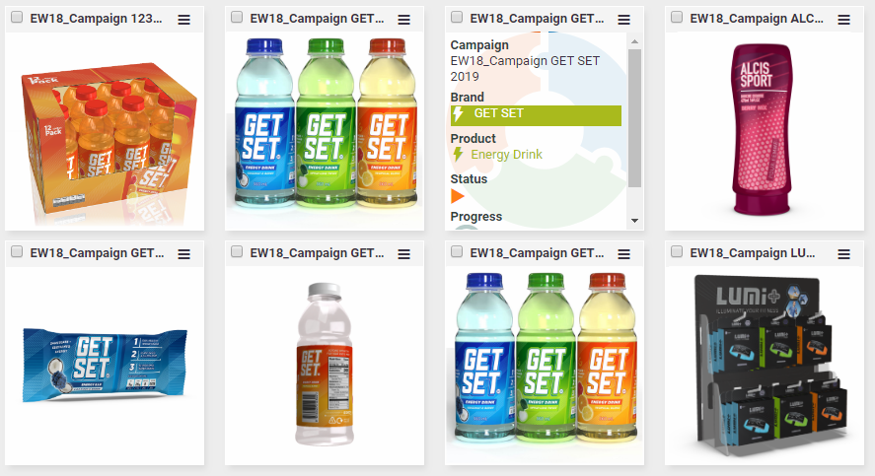
Search UI Improvements
With all of these new searching capabilities we need smarter ways of condensing this all on the page, we therefore introduced various new UI optimizations

Slide 57
Search Inline Editing
Immediately edit the results after you find them from your search

